Slide 1
ES6(ECMAScript 6)
Tarun

Slide 2
cONTENTS
INTRODUCTION
Classes
Arrow Functions
Variables(Let, Const, Var)
Array Methods like .map()
Destructing
Modules
Ternary Operator
Spread Operator

Slide 3
What is ES6?
ES6 stands for ECMAScript 6.
ECMAScript was created to standardize JavaScript, and ES6 is the 6th version of ECMAScript, it was published in 2015, and is also known as ECMAScript 2015.

Slide 4

Why Should I Learn ES6?
React uses ES6, and you should be familiar with some of the new features like:
Classes
Arrow Functions
Variables (let, const, var)
Array Methods like .map()
Destructuring
Modules
Ternary Operator
Spread Operator

Slide 5
React ES6 Classes

Slide 6
Classes
ES6 introduced classes.
A class is a type of function, but instead of using the keyword function to initiate it, we use the keyword class, and the properties are assigned inside a constructor() method.

Slide 7

Example
class Car {
constructor(name) {
this.brand = name;
}
A simple class
Notice the case of the class name. We have begun the name, "Car", with an uppercase character. This is a standard naming convention for classes.

Slide 8

Now we will create objects using the Car class:
Example
Create an object called "mycar" based on the Car class:
class Car {
constructor(name) {
this.brand = name;
}
}
const mycar = new Car("Ford");

Slide 9
React ES6 Arrow Functions

Slide 10
About Arrow FUnctions
The arrow function is a new feature of ES6, introduced in ReactJS 16. It allows the developer to create a function that has lexical “this” binding and no arguments.
Arrow functions offer a compressed and short version of a function expression and need fewer keystrokes than regular JavaScript functions from the developer and can be used as a simpler alternative to functions within class components and functional components and event handlers in React.
Arrow functions are always anonymous, meaning there is no need to use the keyword “function” when defining them. They also do not have their own this value, meaning that this inside an arrow function will refer to the one where it was created rather than where it was called from.

Slide 11
Syntax of an Arrow Function
An arrow function expression is a JavaScript expression that has a shorter syntax than the function keyword. It is designed for situations where you want to create a one−line anonymous function expression, like in event handlers.
Example
It can be used as a more concise replacement for the following −
let handleClick = function(parameter) { return something }; handleClick();
Output
The arrow function expression syntax for the above function is as follows
let handleClick = (parameter) => { something };

Slide 12

An arrow function expression always has a single parameter, following the => token, and then an expression or statement within parentheses that follow the return value using the parameter.
They have lexical scoping and do not have their own this context or arguments object like traditional functions do.
Parentheses are still necessary if the function accepts more or fewer arguments, even though one argument functions do not require them.

Slide 13
When to use Arrow Functions?
Arrow functions are great for performance and making declarative code more readable.
Although they are not always the best choice, they do have some advantages that make them worth considering.
In answer to the question, When to use them?, here are some scenarios −
When you need to bind this to a method
When you want a method to be called on a component's props
When you want to use a callback function

Slide 14

Arrow Function With Parameters
hello = (val) => "Hello " + val;
In fact, if you have only one parameter, you can skip the parentheses as well:
Arrow Function Without Parentheses
hello = val => "Hello " + val;

Slide 15
What About this?
The handling of this is also different in arrow functions compared to regular functions.
In short, with arrow functions there is no binding of this.
In regular functions the this keyword represented the object that called the function, which could be the window, the document, a button or whatever.
With arrow functions, the this keyword always represents the object that defined the arrow function.
Let us take a look at two examples to understand the difference.
Both examples call a method twice, first when the page loads, and once again when the user clicks a button.
The first example uses a regular function, and the second example uses an arrow function.
The result shows that the first example returns two different objects (window and button), and the second example returns the Header object twice.

Slide 16
React ES6 Variables

Slide 17
Variables
.
Before ES6 there was only one way of defining your variables: with the var keyword. If you did not define them, they would be assigned to the global object. Unless you were in strict mode, then you would get an error if your variables were undefined.
Now, with ES6, there are three ways of defining your variables: var, let, and const

Slide 18
var var x = 5.6;
If you use var outside of a function, it belongs to the global scope.
If you use var inside of a function, it belongs to that function.
If you use var inside of a block, i.e. a for loop, the variable is still available outside of that block.
var has a function scope, not a block scope.

Slide 19
let let x = 5.6;
let is the block scoped version of var, and is limited to the block (or expression) where it is defined.
If you use let inside of a block, i.e. a for loop, the variable is only available inside of that loop.
let has a block scope.

Slide 20
const const x = 5.6;
const is a variable that once it has been created, its value can never change.
const has a block scope.
The keyword const is a bit misleading.
It does not define a constant value. It defines a constant reference to a value.
Because of this you can NOT:
Reassign a constant value
Reassign a constant array
Reassign a constant object
But you CAN:
Change the elements of constant array
Change the properties of constant object

Slide 21

Array Methods There are many JavaScript array methods.
One of the most useful in React is the .map() array method.
The .map() method allows you to run a function on each item in the array, returning a new array as the result.
In React, map() can be used to generate lists.
Example
Generate a list of items from an array:
const myArray = ['apple', 'banana', 'orange'];
const myList = myArray.map((item) => <p>{item}</p>)

Slide 22
Destructuring

Slide 23

What is Destructuring?
Destructuring makes it easy to extract only what is needed. To understand it, suppose we have a refrigerator, and we have to prepare a paneer gravy recipe. Do you take everything out of the refrigerator to make your recipe?
No, you only take out the items you would like to use in your recipe.
Destructuring is the same. We may have an array or object that we are working with, but we only need some of the items out of that array.

Slide 24
How to use Destructuring?
We will try to understand Destructuring in below two ways.
Destructuring Array
Destructuring Objects

Slide 25
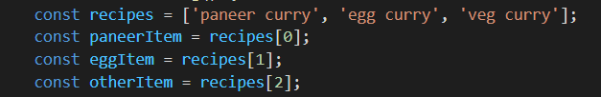
Array Destructuring – This is old way (without Destructuring) of fetching values from an array. Based on index we are getting item.
Below example is with using Destructuring. When Destructuring arrays, the order that variables are declared is important.

Slide 26
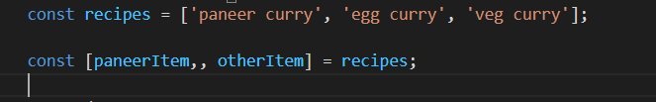
If we only want the paneerItem and otherItem we can simply leave out the eggItem but keep the comma.

Slide 27
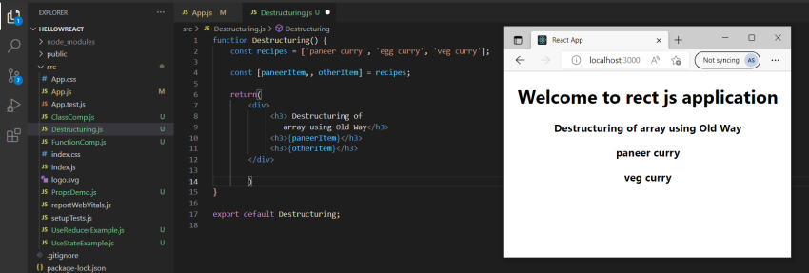
We can simply print this.

Slide 28
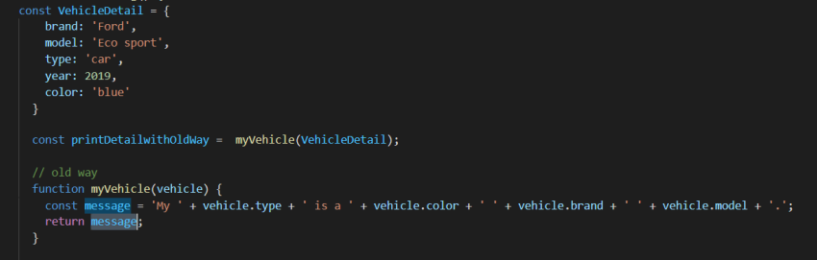
Object Destructuring
Old way(without destructure) of doing it by using a object inside a function as given example below.

Slide 29
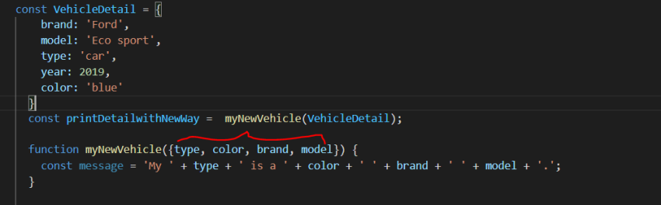
New way (using destructure) of using an object inside a function, We can clearly see what every property is required that only getting fetched from vehicle Detail object in function.

Slide 30
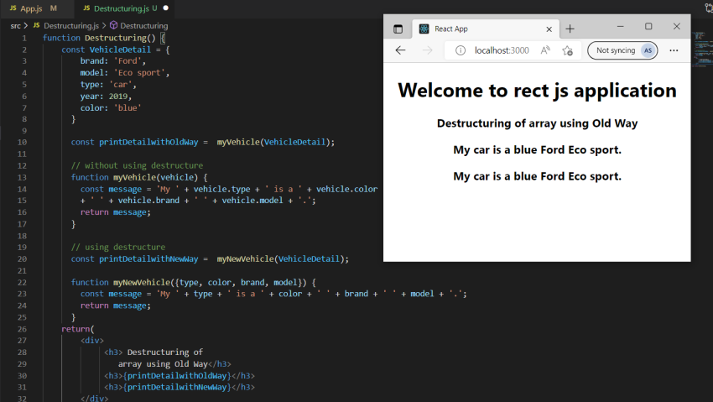

Slide 31
Spread Operator

Slide 32
The JavaScript spread operator (...) allows us to quickly copy all or part of an existing array or object into another array or object.
Example
const numbersOne = [1, 2, 3];
const numbersTwo = [4, 5, 6];
const numbersCombined = [...numbersOne, ...numbersTwo];
The spread operator is often used in combination with destructuring.

Slide 33
Assign the first and second items from numbers to variables and put the rest in an array:
const numbers = [1, 2, 3, 4, 5, 6]; const [one, two, ...rest] = numbers;
We can use the spread operator with objects too

Slide 34
Modules

Slide 35
JavaScript modules allow you to break up your code into separate files.
This makes it easier to maintain the code-base.
ES Modules rely on the import and export statements.

Slide 36
Export
You can export a function or variable from any file.
Let us create a file named person.js, and fill it with the things we want to export.
There are two types of exports: Named and Default.

Slide 37
Named
In-line individually:
person.js
export const name = "Jesse"
export const age = 40
All at once at the bottom:
person.js
const name = "Jesse“
const age = 40
export { name, age }

Slide 38
Default Exports
Let us create another file, named message.js, and use it for demonstrating default export.
You can only have one default export in a file.
Example
message.js
const message = () => {const name = "Jesse";
const age = 40; return name + ' is ' + age + 'years old.';
};
export default message;

Slide 39
Import
You can import modules into a file in two ways, based on if they are named exports or default exports.
Named exports must be destructured using curly braces. Default exports do not.
Import from named exports
Import named exports from the file person.js:
import { name, age } from "./person.js";
Import from default exports
Import a default export from the file message.js:
import message from "./message.js";

Slide 40
Ternary Operator
The ternary operator is a simplified conditional operator like if / else.
Syntax: condition ? <expression if true> : <expression if false>
Here is an example using if / else:

Slide 41
Before:
if (authenticated) {
renderApp();
} else {
renderLogin();
}
Here is the same example using a ternary operator:
With Ternary
authenticated ? renderApp() : renderLogin();

